Slide 1
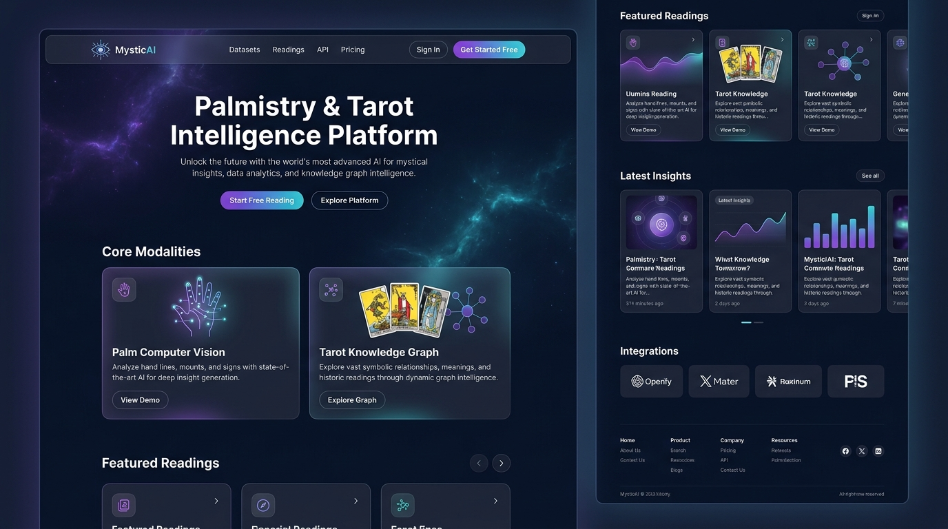
INFOSYS SPRINGBOARD CAPSTONE
01 / 07
MysticAI: Next-Gen Palmistry & Tarot Intelligence
Multimodal AI Spiritual Intelligence Platform
Bridging ancient esoteric divination (Tarot & Palmistry) with modern Computer Vision, Google Gemini 2.0 Flash LLM, and full-stack reactive microservices.
🖥️ LIVE PLATFORM HERO & INTERACTION PORTAL
● PRODUCTION READY
🃏 3D Interactive Card Draw
Physics-driven visual shuffle, fanning & real-time 3D flip card picks
🤖 Gemini Conversational AI
Context-aware spiritual chatbot with domain-tuned guidance prompts
✋ CV Palm Line Intelligence
Automated line detection, feature extraction & Big Five personality mapping
🛡️ Enterprise Polyglot Core
FastAPI async engine + Next.js 14 + PostgreSQL, MongoDB & Redis
78 Cards · 6 Spreads
Full Major & Minor Arcana graph
4-Tier RBAC & JWT
Enterprise security & audit logging

Slide 2
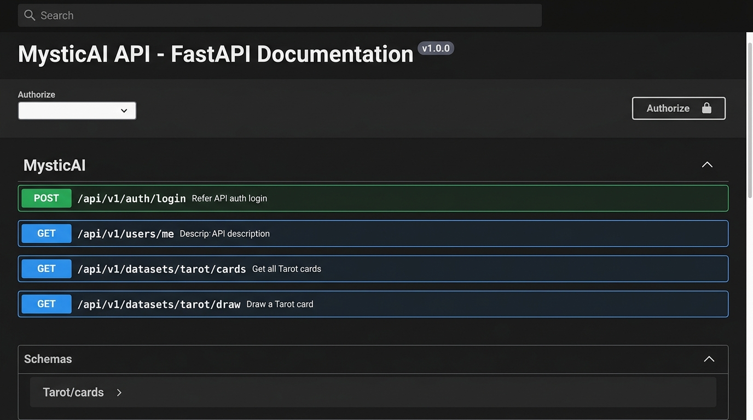
SYSTEM DESIGN & DATA FLOW
02 / 07
System Architecture: Dual-Database Polyglot Engine
⚡ Frontend Client Layer (Next.js 14)
▪ React 18 + Next.js App Router for dynamic routing & SEO
▪ TailwindCSS + Framer Motion for 3D card flips & glassmorphism
▪ Real-time state hydration with JWT bearer interceptors
🖥️ INTERACTIVE FASTAPI SWAGGER / REDOC API DOCS
● FULLY DOCUMENTED
🚀 Async Application Layer (FastAPI)
▪ High-throughput Python 3.11 asynchronous REST microservices
▪ Strict Pydantic v2 contract validation for all payloads
▪ Modular routers: Auth, Readings, AI Chat, Datasets, Analytics
🗄️ Polyglot Dual-Database Layer
▪ PostgreSQL (SQLAlchemy): ACID user auth, roles & transactions
▪ MongoDB (Motor): Flexible NoSQL reading logs, card spread graphs
▪ Redis: Token blacklisting, session caching & rate limiting
🐳 Dockerized Microservices & Unified Orchestration
▪ Single-command initialization via `docker-compose up -d`
▪ Isolated container networks for PostgreSQL (5432), MongoDB (27017), Redis (6379) & FastAPI (8000)

Slide 3
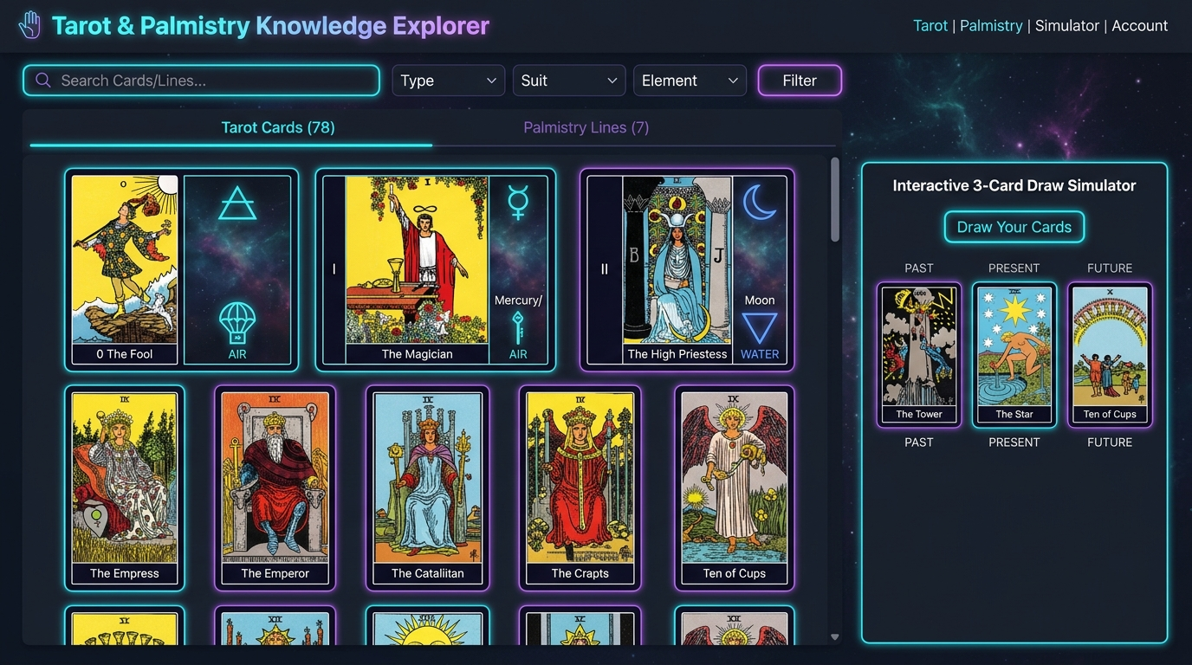
MULTIMODAL INTELLIGENCE
03 / 07
Core AI Engines: 3D Interactive Tarot & Palm CV
🖥️ DIGITIZED KNOWLEDGE BASE & SPREAD EXPLORER
● 78 CARDS + PALM DATA
🃏 3D Physics Interactive Tarot Engine
▪ Interactive Card Draw: Physics-based visual deck shuffle, card fanning, and manual one-by-one pick flow
▪ 3D CSS & Framer Flip: Recreates authentic physical tactile experience with flip animation & upright/reversed state
▪ Elemental & Astrological Mapping: Cards mapped to Fire, Water, Air, Earth, Zodiac signs, and planetary rulers
▪ Deterministic + AI Synthesis: Position-specific meanings fused into dynamic multi-card narratives
✋ Computer Vision Palm Line Detection
▪ 5 Major/Minor Line Analysis: Heart (Emotions), Head (Intellect), Life (Vitality), Fate (Destiny), Sun (Creativity)
▪ Morphological Feature Extraction: Quantifies length, curvature, depth, fork branches, and line breaks
▪ Personality Archetype Engine: Mapped into Big Five personality metrics (Openness, Conscientiousness, Extroversion, etc.)
▪ Dual Input Mode: Supports real-time camera image upload or manual interactive parameter calibration
🔮 6 Standard Spread Frameworks Supported:
Single Card · Past-Present-Future · Celtic Cross (10 Cards) · Career Path · Love & Relationship · Horseshoe

Slide 4
COGNITIVE ARCHITECTURE
04 / 07
Multimodal AI & Gemini 2.0 Conversational Chatbot
🤖 Google Gemini 2.0 Flash Integration
▪ Low-latency streaming inferences via `@google/genai` API
▪ System instruction engineering enforcing empathetic, mystical yet grounded tone
▪ Structured JSON response enforcement for cards, traits & recommendations
🧠 Context-Aware Memory & Persona
▪ Multi-turn conversation history retained with session sliding window
▪ Dynamic user profile injection (Zodiac sign, life path, previous readings)
▪ Dual-mode execution: Live Gemini LLM or Offline Rule-based Template Engine
🔮 Deep Narrative Synthesis Engine
▪ Cross-modal fusion: Synthesizes Tarot card archetypes + Palmistry lines
▪ Multi-dimensional scoring across 4 life pillars: Career, Love, Health & Spirit
▪ Dynamic confidence scoring based on card harmony & line strength
💡 Personalized Recommendation Engine
▪ Actionable daily affirmations & mindfulness spiritual practices
▪ Crystal & gemstone pairings with elemental balancing advice
▪ Automated PDF & Word document generation for downloadable personal dossiers

Slide 5
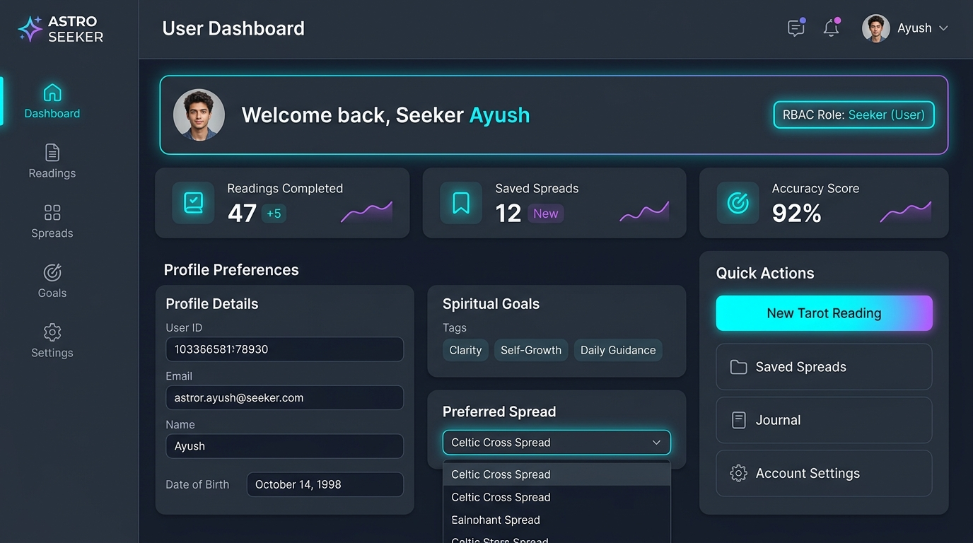
SECURITY & ANALYTICS
05 / 07
Enterprise Security, 4-Tier RBAC & Analytics Dashboard
🖥️ USER ANALYTICS & PROFILE DASHBOARD
● 4 ROLES ACTIVE
👥 4-Tier Role-Based Access Control (RBAC)
🔮 Seeker (End User): Perform personal Tarot & Palm readings, chat with AI, view history
🃏 Tarot Reader: Manage client readings, customize interpretations, annotate spreads
🌿 Consultant: Access holistic life trend reports, suggest lifestyle remedies & crystals
👑 Administrator: Full user CRUD, system metrics, dataset moderation & audit logs
📈 Life Trend Analytics & Opportunity Forecasting
▪ Historical Pattern Detection: Tracks recurring Arcana suits (Cups, Wands, Swords, Pentacles) across user timeline
▪ Emotional & Career Forecasts: Identifies upcoming astrological peaks & growth opportunities
▪ Confidence & Harmony Scoring: Real-time statistical confidence metrics based on line clarity & card synergy
▪ Multi-Format Reporting: Instant one-click export to PDF / DOCX full spiritual dossiers
🔐 Enterprise Security & Token Lifecycle:
Bcrypt password hashing · HMAC-SHA256 JWT tokens · Redis token blacklisting on logout · CORS & Rate limiters

Slide 6
INFOSYS SPRINGBOARD MILESTONES REVIEW
06 / 07
Comprehensive Milestone Delivery: 100% Completion (M1 - M4)
MILESTONE 1: Foundations, Polyglot DB & RBAC
● 100% DELIVERED
MILESTONE 2: Multimodal Engines & 1,000-Image Catalog
● 100% DELIVERED
▪ ⚡ FastAPI Async Core: 30+ production REST endpoints with strict Pydantic v2 schemas
▪ 🗄️ Dual-Database Layer: PostgreSQL (ACID) + MongoDB (NoSQL) + Redis (Cache/Blacklist) with SQLite fallback
▪ 🔐 Enterprise Security: Bcrypt hashing, HMAC-SHA256 JWT tokens, Redis token blacklist & CORS middleware
▪ 👥 4-Tier RBAC Engine: Seeker, Tarot Reader, Consultant & Super Admin with 12 granular permissions
▪ 📑 OpenAPI 3.0 Contracts: Interactive Swagger UI & ReDoc specs with 100% endpoint documentation parity
▪ ✋ CV Palm Analysis Engine: 5 lines (Heart, Head, Life, Fate, Sun) with curvature, clarity & depth extraction
▪ 🌿 Hand Morphology Analysis: Earth, Air, Fire, Water elemental hand classifications & trait mapping
▪ 🃏 78-Card Tarot Deck & Spreads: 6 distinct spread architectures, position-specific semantics & reverse orientations
▪ 📂 1,000-Image Dataset Catalog: 500 labeled palms + 500 multi-style tarot cards with search & filter APIs
▪ 📷 Dual Input Mode: Live camera scanner with HUD overlay guide + multipart image file upload
MILESTONE 3: AI Interpretation, Personality & Trends
● 100% DELIVERED
MILESTONE 4: Interactive UX, Dashboards & Quality
● 100% DELIVERED
▪ 🤖 Gemini 2.0 Flash LLM: Domain-tuned prompt engineering for empathetic, mystical & grounded insights
▪ 🔮 Cross-Modal Synthesis: Deep narrative fusion synthesizing biometric palm lines with tarot card archetypes
▪ 🧠 Big Five Personality Engine: OCEAN trait modeling + 10 spiritual archetypes with strengths & behavioral patterns
▪ 📈 Life Trend Forecasting: Tracks 5 life dimensions (Emotional, Career, Spiritual, Vitality, Creative)
▪ ⚖️ 5-Factor Weighted Scoring: Normalized 0-100 score (30% Palm, 25% Tarot, 20% Persona, 15% Context, 10% Consistency)
▪ 🃏 3D Physics Card Draw: Interactive visual shuffle, fanning, one-by-one manual pick & 3D CSS flips
▪ 💬 Conversational AI Chatbot: Multi-turn spiritual dialogue with session memory & offline rule fallback
▪ 📊 4 Role-Based Dashboards: Tailored consoles for Seeker, Tarot Reader, Spiritual Consultant, Super Admin
▪ 📄 Multi-Format Dossier Export: One-click export of complete spiritual guidance dossiers to PDF, DOCX, CSV & JSON
▪ 🧪 100% Verified Quality: 63/63 pytest automated tests passing in 3.11s + Docker Compose deploy

Slide 7
VERIFICATION & IMPACT
07 / 07
Quality Engineering, Test Verification & Future Roadmap
🧪 Automated Test Suite & Verification
● 63/63 PASS (100%)
🚀 Production Infra & Future Horizon
● ENTERPRISE READY
▪ Pytest Execution Speed: All 63 unit and integration tests execute cleanly in ~3.11s with 0 failures
▪ Auth & Security Verification: Validates bcrypt hashing, JWT token expiry, blacklisting & RBAC permission bounds
▪ Reading Engine Integrity: Verifies all 6 tarot spreads, card uniqueness, elemental balance & palm determinism
▪ AI Scoring Math Validation: Ensures strict compliance with 5-factor weighted scoring formula & letter grades (A+ to D)
▪ Data Export Fidelity: Validates complete data export structures for CSV, JSON, and PDF dossiers
▪ Resilience & Offline Fallbacks: Guarantees graceful degradation when Gemini API key or external DBs are offline
▪ Strict Schema Enforcement: Zero runtime data corruption via strict Pydantic v2 request/response validation
▪ Docker Container Network: Single-command containerization for PostgreSQL, MongoDB, Redis & FastAPI services
▪ Live WebRTC Palm Tracking: Drop-in MediaPipe edge machine learning for real-time video landmark analysis
▪ Cross-Platform Mobile Apps: React Native iOS & Android companion applications with haptic vibration card flips
▪ Multilingual Neural Voice: Real-time voice-guided tarot reading & audio affirmations across 12+ languages
▪ WebXR Immersive Sanctum: 3D VR spiritual sanctum supporting interactive virtual reality deck interactions
▪ Practitioner Marketplace: Live video consultation booking system with verified professional tarot readers
▪ Continuous Cloud Delivery: Automated GitHub Actions CI/CD pipeline targeting Vercel & Railway/Render

